Slide 1
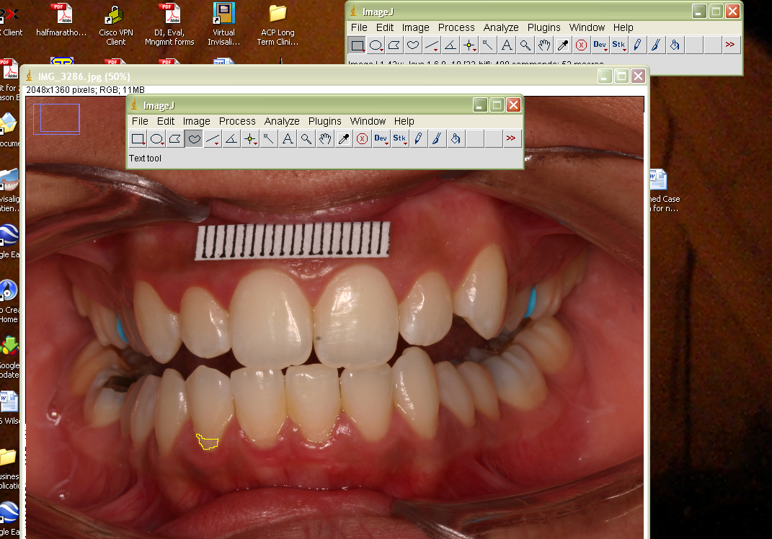
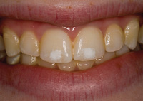
Title of the Presentation
Author’s First name Initial Last name, First name Initial Last name
ABSTRACT
METHODOLOGY
(Abstract is required by AADR, but for other venues you can use a summary)
(Describe the method used, using pictures or schematics as needed. “A picture is worth a thousand words.” This could be a Consort Flow Chart.)
Example:
(RED = INSTRUCTIONS: These elements can be arranged as needed to accommodate the information you want to transmit. Use as many images as possible, and as few words as possible. There are recommended font sizes used in this document. This poster format creates a poster 3’ wide by 4’ tall.)
(Replace Mozart’s picture with the facial picture of the presenter or first author.)
These two red text sections contain guideline information and are to be deleted.)
RESULTS
(Use graphs, charts and tables as much as possible. )
Example:
INTRODUCTION
(Keep it short and sweet. Use pictures that can decrease number of words. Example: )
(RED = INSTRUCTIONS: The title banner is RGB:0,0,255 background with title in Ariel 72, and authors in Ariel 60.
The section titles are Dark blue, Text 2, 80% lighter on the color palette, RGB:198,217,241 in Ariel 48.
The text is Ariel,36.
The section titles are aligned 2 inches from the edge and 2 inches from the midline.
The text sections are ½ inch from the edge and ½ inch from the midline.)
PURPOSE
Determine………
(INTERVENTION, MATERIALS STUDIED)
(Identify the intervention investigated, the materials studied, or unique circumstances .
Give the trade name of any product and identify the company, city and state. This identification is give ONCE, and then referred to by an acronym , or generic term , in other references to the material.)
CLINICAL IMPLICATIONS
(What are the clinical implications from this investigation?)
CONCLUSIONS
List conclusions.
Conclusions are not the results but what is learned from the results.
There should be one or more conclusions or at least a summary statement.
ACKNOWLEDGEMENTS
(Identify any funding source, companies that provided any material support, assistants in the study that are not authors)

